Slide 1
UDE1001
Introduction to Design Innovation
Submission Template A1 & A2

Slide 2
Table of Contents and Assessment Criteria
A1 – Individual Research (50%) | 50 pts | Session | Checkbox
Research Plan​ | 7 | 1
Problem Framing | 5 | 1
Discussion Preparation | 5 | 1
Three Interviews (minimum) | 6 | 2
Empathy Map | 7 | 2
Interview & Observation Insights | 5 | 2
Persona | 5 | 3
“Before” Journey Map | 5 | 3
How Might We | 5 | 3
Criteria for A1 (50 pts)
Methodology
Empathy
Questions
Observations
Insights
A2 – Group Project (50%) | 50 pts | Session | Checkbox
Team choose one topic |  | 4
Frame the intention together |  | 4
Ideation Sketches |  | 4
“After” Journey Map |  | 4
Low Fidelity Prototype, photos, videos |  | 4
Refined Prototype, prepare presentation |  | 5
Observations, Reflections, Learning |  | 6
Self & Peer Evaluation | 10 | 6
Criteria for A2 (50 pts)
10pts: Creativity, originality
10pts: Impact potential / Value generated
10pts: Criticality & Justification
10pts: Presentation
10pts: Self & Peer Evaluation
Notes:
After sharing about our PET, CET and applied research capabilities, I would now like to share about our living labs as part of our move to our Punggol new campus in 2024.
Labelled as the Punggol Digital District, it houses key digital players like Wan Xiang, Dconstruct and Cyber Security Agency of Singapore.
Currently, we operate out of 6 different locations across Singapore

Slide 3
General Information
Student ID | Full Name | Email | 1.Muhammad Farhan Bin Ahmad 2. 3. 4. 5.
Program | UDE 1001
Group | 5
Date and Time Submitted:
Notes:
After sharing about our PET, CET and applied research capabilities, I would now like to share about our living labs as part of our move to our Punggol new campus in 2024.
Labelled as the Punggol Digital District, it houses key digital players like Wan Xiang, Dconstruct and Cyber Security Agency of Singapore.
Currently, we operate out of 6 different locations across Singapore

Slide 4
A1 – Pre course Survey
About you and Critical Thinking, Design Thinking & Innovation
Do I think critically and deeply?
2. Do I consider myself creative and able to design?
3. Do I consider myself to be innovative?
0 not at all
10 yes absolutely
7/10
0 not at all
10 yes absolutely
7/10
0 not at all
10 yes absolutely
7/10
Notes:
After sharing about our PET, CET and applied research capabilities, I would now like to share about our living labs as part of our move to our Punggol new campus in 2024.
Labelled as the Punggol Digital District, it houses key digital players like Wan Xiang, Dconstruct and Cyber Security Agency of Singapore.
Currently, we operate out of 6 different locations across Singapore

Slide 5
A1 - Research Plan​
Did you choose your topic thoughtfully?
What is your research objective?
e.g. We want to find the current challenges
What do we already know?
e.g. quantitative data insight
What are we unsure about? e,g customer motivations, perceptions…
Who do we need to talk to?
e.g. customers, service staff, supplier…
ITE students facing prejudice from the general public
Law.M,2013,We need to guard against elitism: ESM Goh:https://sg.news.yahoo.com/we-need-to-guard-against-elitism--esm-goh-024750768.html(16/1/2018)
Ngering.R,2013,How Is Singapore’s Education System Unequal?,https://thehearttruths.com/2013/11/21/how-is-singapores-education-system-unequal(17/1/2018)/
The Independent,2016,ite and poly education is bad rubbish did tony tan say that,
http://www.theindependent.sg/ite-and-poly-education-is-bad-rubbish-did-tony-tan-say-that/
Where did this hostility come from?
ITE Students , ITE lecturers, General public
Why does this topic matter to me?
e.g. why do you care?
What are the other relevant data sources?
e.g. existing research, social media, consumer
Close friends experience
Newspaper Article , Social media post
Notes:
After sharing about our PET, CET and applied research capabilities, I would now like to share about our living labs as part of our move to our Punggol new campus in 2024.
Labelled as the Punggol Digital District, it houses key digital players like Wan Xiang, Dconstruct and Cyber Security Agency of Singapore.
Currently, we operate out of 6 different locations across Singapore

Slide 6
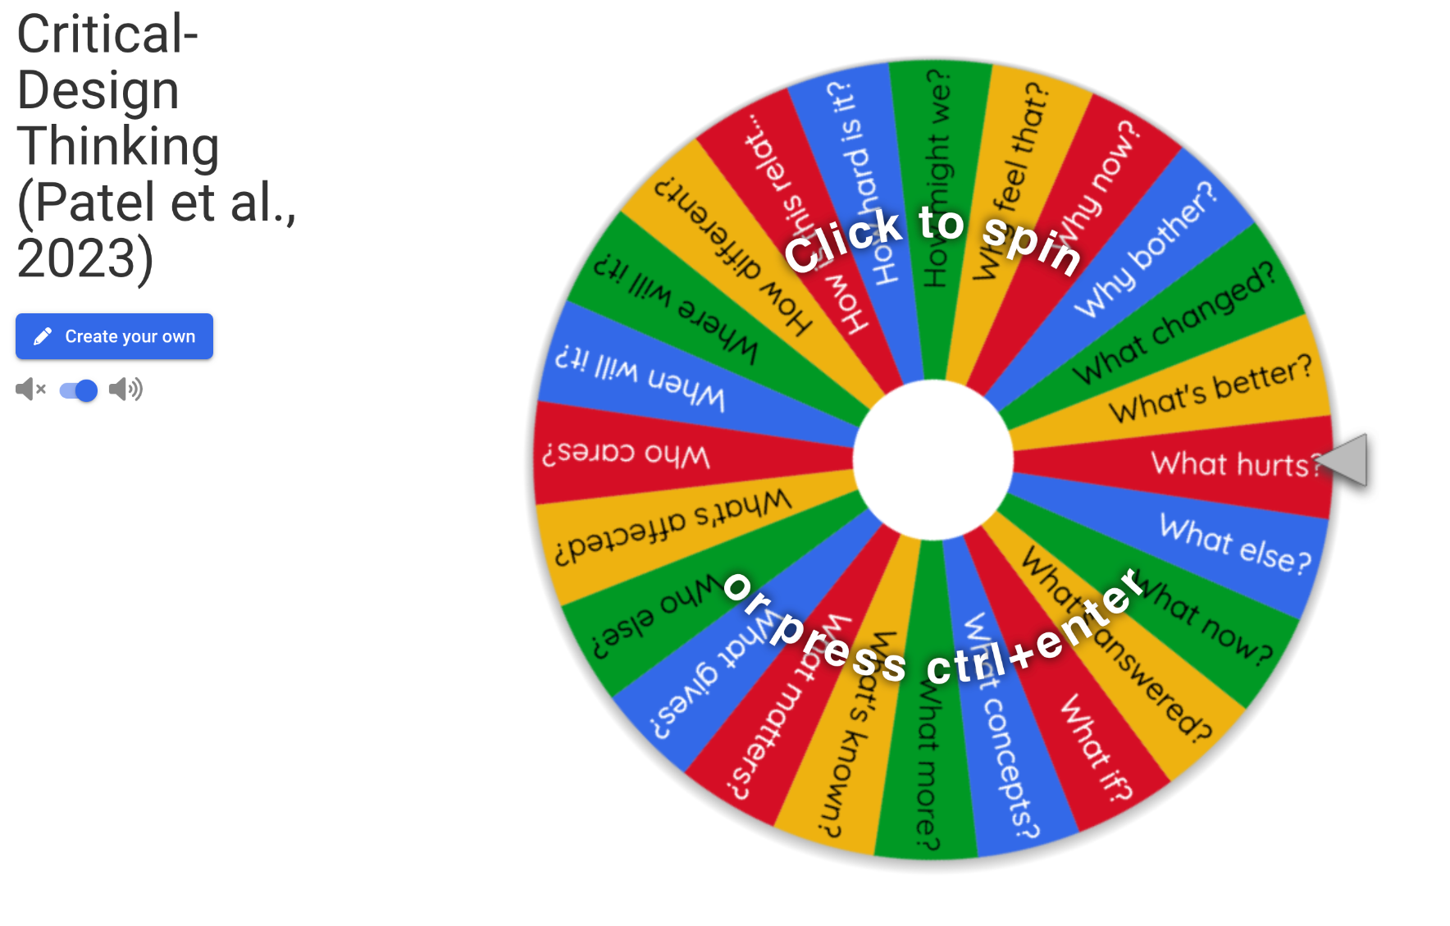
A1 - Problem Framing (Topic or Interest Area)
Did you narrow down the scope of investigation, and are you ready to challenge your assumptions?
We believe [this specific customer]:__ITE students
Needs a better way to [meet this need]:Better public image
Because of [this insight] : Misrepresentation and prejudice
Think critically, go deeper, spin 5 times and answer:
How might we: Interview and discussion with students, alumni and the general public
Why bother: Unfair and discrimination against them without giving them a proper chance to prove themself
Why feel that: Because they’re still trying their best with what they have and it’s unfair for people to look down on those to dare tries
What’s affected: Current student and secondary school students(especially for those taking O and N level )
Who cares: Students in ITE, Secondary students who have not score well, parents who fear for their child’s future
https://wheelofnames.com/4qn-bww
Notes:
After sharing about our PET, CET and applied research capabilities, I would now like to share about our living labs as part of our move to our Punggol new campus in 2024.
Labelled as the Punggol Digital District, it houses key digital players like Wan Xiang, Dconstruct and Cyber Security Agency of Singapore.
Currently, we operate out of 6 different locations across Singapore

Slide 7
A1 - Discussion Preparation
Are you ready to build trust, connect, ask powerful questions that lead to insights?
1. Introduce yourself
Share the purpose of the interview, how long it will take, it’s anonymous
2. Warm up
Ask the participants some simple questions about themselves, connect on a personal level, build trust
3. Introduce the topic
Ask them to share their experiences and personal stories, and how they feel about these situations
4. Dig deeper
Find out their motivation, perception, fear, concerns, hopes
5. Wrap up
Thank them and offer them to add any message they want to be heard
Hello, I’m currently doing a research regarding prejudice against ITE students. Could you spare a few minute to share your thoughts regarding this situation?
Were/Are you an ITE student or do you know anyone who is an ITE student? How was it like being an ITE student?
Do you know anyone who is/was an ITE student? How did you feel about them being ITE students?
I’m currently doing a research regarding the public’s opinion towards ITE students
Could you share your thoughts and opinion regarding this issue?
Where do you think this prejudice stem from? Where do you think this all started?
What are your thoughts on ITE students?
Thank you for sharing your precious time to answer my question. Have a good day
Notes:
After sharing about our PET, CET and applied research capabilities, I would now like to share about our living labs as part of our move to our Punggol new campus in 2024.
Labelled as the Punggol Digital District, it houses key digital players like Wan Xiang, Dconstruct and Cyber Security Agency of Singapore.
Currently, we operate out of 6 different locations across Singapore

Slide 8
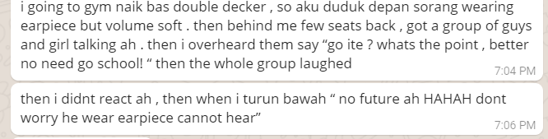
A1 - Three interviews (minimum)
Go interview strangers and learn!
Interview 1
Interview 2
Interview 3
Going back home from the gym, a group of students(he choose not to share from what school they are from),mistaken that he could not hear them due to him wearing a Bluetooth earpiece, proceeded to make fun of him when he was leaving the bus.
Her parents were fearful that entering ITE was a “death sentence” to her education due to their believe that ITE was filled with Malay gangster and bad influence
Excerpt from the interview:
“My parents always had bigger dreams for me to continue on to Secondary 5 but they expected that I would end up in ITE. Even if they didn't look at me differently, they still supported me for my decision to join ITE. They feared that ITE would influence me to join gangs, and pick up bad habits like smoking or loitering around in public.”
Was afraid that upon graduating ITE, that he will outcasted by polytechnic students because of ITE bad reputation among the general public and will be seen as “slow” to some of his future peers
Excerpt from the interview:
“I definitely fear rejection. I feel like giving up because I felt like I didn't give it my best when I know I already did. At the same time, I have faith that I can survive. I know that I have at least my strengths and new-found skills that I can use when I enter Polytechnic and the working world…”
“I’m afraid of being outcasted as “that guy” just because of being in ITE. I’m afraid of not being accepted by my peers and ended up being alone for my entire Poly life. I want to show them that although I came from ITE, I can still succeed in my studies and prove to all that ITE does not equal to the end. You’re just taking a longer path that's all…”
Notes:
After sharing about our PET, CET and applied research capabilities, I would now like to share about our living labs as part of our move to our Punggol new campus in 2024.
Labelled as the Punggol Digital District, it houses key digital players like Wan Xiang, Dconstruct and Cyber Security Agency of Singapore.
Currently, we operate out of 6 different locations across Singapore

Slide 9
A1 - Empathy Map
Don’t judge a book by its cover, carefully study the whole iceberg.
That him being in ITE is just bad due to its reputation.
That his education career is “dead”
Think & Feel
What really matter, major preoccupations worries & aspirations
That he is able to continue his study and, for now, be able to find a job to support his family
Hear
What family, friend, boss, colleagues, media says
See
Environment, friends, what the world offers
Greg
Person
Don’t see much of a future in his career education. Sees a bleak future
Say & Do
Attitude in public, appearance, behaviours, actions
The moment they see him in an ITE uniform or found out he’s from ITE, they either think lowly of him or show hostility towards him.
Fear that there is no hope for him anymore due to being in ITE. Have a generally negative outlook towards the future
Just wish to be able to support himself and his family. A bit materialistic and wish to be able to but more stuff
Pains
Fears, frustrations, obstacles
Gains
Wants, needs, measures of success
Notes:
After sharing about our PET, CET and applied research capabilities, I would now like to share about our living labs as part of our move to our Punggol new campus in 2024.
Labelled as the Punggol Digital District, it houses key digital players like Wan Xiang, Dconstruct and Cyber Security Agency of Singapore.
Currently, we operate out of 6 different locations across Singapore

Slide 10
A1 - Interview & Observation Insights
Translate observations into actionable insights
Criteria | Insight
What happened? (Observations + Source Information) | At the start he was quite happy and open but as the story went on, he became slightly more uncomfortable. Specially when breaking the news to his parents that he had no choice but to enter ITE to continue his education and how people treated him when he was an ITE student. Like when an auntie walk away while giving him a hostile look when she found out that he’s a ITE student after asking for direction. But near the end, he was back to a happier tone, stating how silly it was for him to worry so much
What does it mean? (What is the impact to your project?) | There are people who went to ITE have seem to be “Scarred” by it. They face discrimination and discouragement from people in their family and from the general public. Felt hopeless as this is the end of the line for them.
Notes:
After sharing about our PET, CET and applied research capabilities, I would now like to share about our living labs as part of our move to our Punggol new campus in 2024.
Labelled as the Punggol Digital District, it houses key digital players like Wan Xiang, Dconstruct and Cyber Security Agency of Singapore.
Currently, we operate out of 6 different locations across Singapore

Slide 11
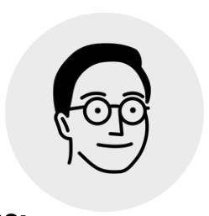
A1 - Persona
From the interviews, outline an abstract persona, with specific characteristics
Sketch
A quote that captures the personality : It is what it is
Name | Greg
Age | 21
Work | Student
Family Status | Single
Location | Singapore
I am student I'm trying get a job and further my education
But afraid to do so
Because people keep saying that “I’m a lost cause”
Which make me feel ashamed and feel that whatever I’m doing to better myself is pointless
Behavior Traits Scale
Digital Novice
Digital Native
Notes:
After sharing about our PET, CET and applied research capabilities, I would now like to share about our living labs as part of our move to our Punggol new campus in 2024.
Labelled as the Punggol Digital District, it houses key digital players like Wan Xiang, Dconstruct and Cyber Security Agency of Singapore.
Currently, we operate out of 6 different locations across Singapore

Slide 12
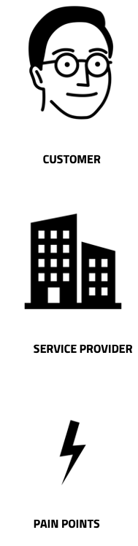
A1 - “Before” Journey Map
Describe the journey of the persona before your “intervention”. Feel free to add columns (touchpoints) rows (other actors)
Before
During
After
What is happening
Unsure of the future and is ashamed of being an ITE student. See himself as a failure
What is happening
Felt hopeless still. That nothing can be done for his education career
What is happening
Feel more confident in himself. Still unsure of the future but now just a bit more hopeful
What is happening
There is not real output to vent or say his piece. Maybe on an online forum but nothing official
What is happening
Felt a bit scared to open up about his issue. However, as conversation when on, start to become more open
What is happening
Felt a sense of relief as he was able to finally open up about his feeling
Pain points
Being an ITE student and being look down because of it. Family thinking that “he’s not smart enough”
Pain points
Felt shame for not being good enough. Embarrass to be an ITE student as he felt that his education “is dead”
Pain points
While still painful, is now more confident and happier with himself and his ability
Notes:
After sharing about our PET, CET and applied research capabilities, I would now like to share about our living labs as part of our move to our Punggol new campus in 2024.
Labelled as the Punggol Digital District, it houses key digital players like Wan Xiang, Dconstruct and Cyber Security Agency of Singapore.
Currently, we operate out of 6 different locations across Singapore

Slide 13
A1 - How Might We
Imagine different directions to address the pain point(s) and improve the situation(s)
How might we create a public campaign
for ITE students
in order to improve their reputation with the general public
How might we create an event
for ITE students
in order to showcase they skill and ability to show that they are skilled and deserve to be look down
How might we offer an outlet
for ITE students
in order to help them be more confident with themselves. That its not the end for them
How might we offer platform
for ITE students
in order to for them to showcase their skills and be able to help and contribute to the community to better improve their image
Notes:
After sharing about our PET, CET and applied research capabilities, I would now like to share about our living labs as part of our move to our Punggol new campus in 2024.
Labelled as the Punggol Digital District, it houses key digital players like Wan Xiang, Dconstruct and Cyber Security Agency of Singapore.
Currently, we operate out of 6 different locations across Singapore

